Slide 1

Google Android Developer Virtual Internship
by
SUSHMITHA C
Roll No. 204G1A05A6
Department of Computer Science and Engineering
Srinivasa Ramanujan Institute of Technology
Autonomous
Rotarypuram Village, B K Samudram Mandal, Ananthapuramu – 515701.
2023-2024

Slide 2

Contents
Introduction
Modules
Modules Explanation
Conclusion
References

Slide 3
Modules
Your first Android app
Building App UI
Display Lists and use material designs
Navigation and app architecture
Connect to the internet
Data persistence
Work Manager
Views and compose

Slide 4
Introduction
Android Basics with Compose:
Android Basics with Compose is a self-paced, online course on how to build Android apps using the latest best practices. It covers the basics of building apps with Jetpack Compose, the recommended toolkit for building user interfaces on Android.
Kotlin Fundamentals:
Kotlin is a modern, statically typed programming language developed by JetBrains. It runs on the Java Virtual Machine (JVM) and can also be compiled to JavaScript or native code. Kotlin is designed to interoperate fully with Java, making it a suitable choice for building Android apps as well as other types of applications.

Slide 5
Your First Android App
Introduction to Kotlin:
Kotlin is a modern and concise programming language that is used to develop Android applications. It offers a range of features and interoperability with Java, making it a popular choice among developers for Android app development.
Setup Android Studio:
Android Studio is the official integrated development environment (IDE) for Android app development. It provides tools for designing UIs, debugging, and performance profiling. Setting up Android Studio is the first step towards building your first Android app.
Build a Basic Layout:
Creating a basic layout involves designing the interface of your app using XML or the Android Studio visual layout editor. This includes adding text views, buttons, images, and other UI elements to create the initial structure of your app.

Slide 6
Building App UI
Adding Button to an App:
When adding a button to an Android app, it's important to consider the placement, size, and styling to ensure a seamless user experience. The button serves as a primary interactive element, so its design should reflect the app's aesthetics and functionality. Applying appropriate touch feedback and animations enhances user engagement and provides visual cues.
Interacting with UI and State:
Interacting with the UI involves handling user input, responding to events, and updating the app's state accordingly. Understanding the lifecycle of UI components and data binding is crucial for efficiently managing user interactions. It's essential to maintain a responsive UI while handling complex states and asynchronous operations.

Slide 7
Display Lists and Use Material Design
Implementing Material Design:
In this step, we integrate the principles of Material Design into our app. This involves utilizing the grid system, color theory, and typography to create a visually appealing and consistent user interface. We will focus on elevation, motion, and depth to enhance the overall user experience.
Building a Scrollable List:
Next, we create a scrollable list that dynamically displays data. This involves implementing the RecyclerView widget to efficiently display large data sets and creating custom list item layouts with Material Design components like cards, tiles, and lists.
Enhancing UI with Animations:
In this final step, we explore adding animations and transitions to our app. We will use Material motion system to bring our UI to life, creating smooth and delightful interactions for an engaging user experience.

Slide 8
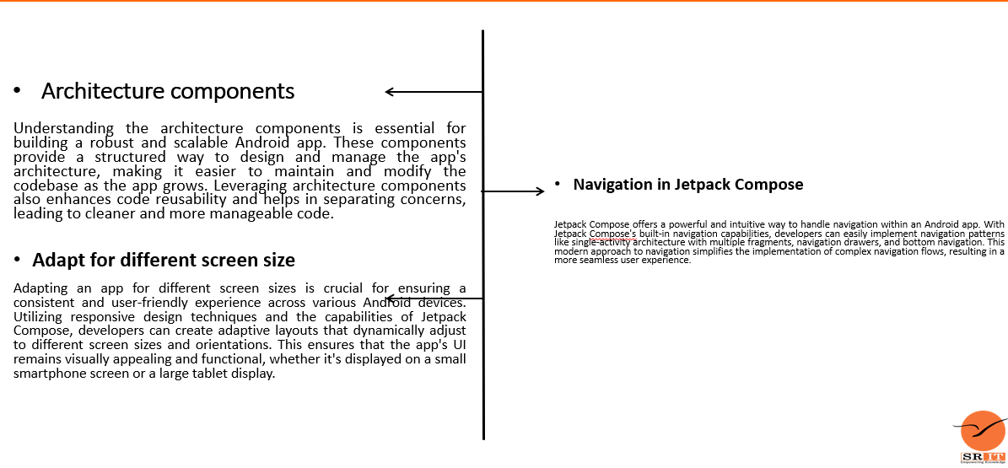
Navigation and App Architecture

Slide 9
Connect to the Internet
Get data from the internet:
When building an Android app, one of the key features is the ability to connect to the internet and retrieve data. This process involves making network requests to fetch information from servers or APIs. It's important to handle this process efficiently and securely to provide a seamless user experience. Additionally, loading and displaying images from the internet is a common requirement in modern apps. This involves fetching image resources from online sources and rendering them within the app interface.
Load and display images from the internet:
Developers often use libraries and frameworks to manage network requests and image loading, ensuring that the app remains responsive while data is being fetched. Proper error handling, caching, and optimizing image loading are crucial aspects to consider in this context. Whether it's displaying user avatars, product images, or dynamic content from the web, the ability to integrate internet connectivity and image loading is a fundamental skill for Android developers.

Slide 10
Data Persistence
Introduction to SQL
Understanding SQL is essential for effective data persistence. It allows for efficient manipulation and retrieval of data, providing a strong foundation for building and managing databases.
Use Room for Data Persistence
Room is a powerful library that simplifies the process of working with SQLite databases in Android. It provides an abstraction layer over raw SQLite to allow for more robust database interactions.
Store and Access Data Using Keys with Datastore
Datastore offers a modern, reactive, and flexible approach to data management. It allows for efficient and consistent data access using key-value pairs, offering seamless integration with the Android platform.

Slide 11
Work Manager
Scheduling Tasks
-Defining and scheduling background tasks
Constraints
-Setting constraints for running tasks
Observing Task Status
-Monitoring and handling task statuses
The Work Manager in Android allows developers to schedule deferrable and reliable background tasks. It provides a way to specify constraints for when the task should run, such as network availability or device charging status. Additionally, developers can observe the status of the scheduled tasks to handle success or failure scenarios effectively. Using the Work Manager, developers can ensure that tasks are executed at the right time, under the specified conditions, and with the required level of reliability.

Slide 12
Views and Compose
Android Views
Android views play a crucial role in the user interface of mobile applications. They contribute to the overall layout, navigation, and interaction within the app, offering a visually engaging and intuitive experience to the users.
Compose in Views
Jetpack Compose revolutionizes the building of UIs in Android apps by offering a declarative way to create user interfaces. It allows for easy customization, efficient development, and seamless integration of interactive components.
Views in Compose
Integrating views in Jetpack Compose opens up a world of possibilities for creating stunning and dynamic user interfaces. It empowers developers to design visually appealing apps with fluid animations and responsive interactions.

Slide 13
Conclusion
Comprehensive Learning Experience:
Throughout this course, I have gained a comprehensive understanding of Android app development, including the fundamentals of Kotlin, building app UI, data management, and connecting to the internet.
Integration of Modern Practices:
By exploring architecture components, navigation in Jetpack Compose, and adapting for different screen sizes, you have internalized the importance of incorporating modern practices into app development.
Emphasis on User Experience:
The focus on displaying lists, using material design, and loading data from the internet has equipped you to create engaging and aesthetically pleasing apps that prioritize user experience.

Slide 14
References
[1] https://developer.android.com/courses
[2] https://internship.aicte-india.org

Slide 15
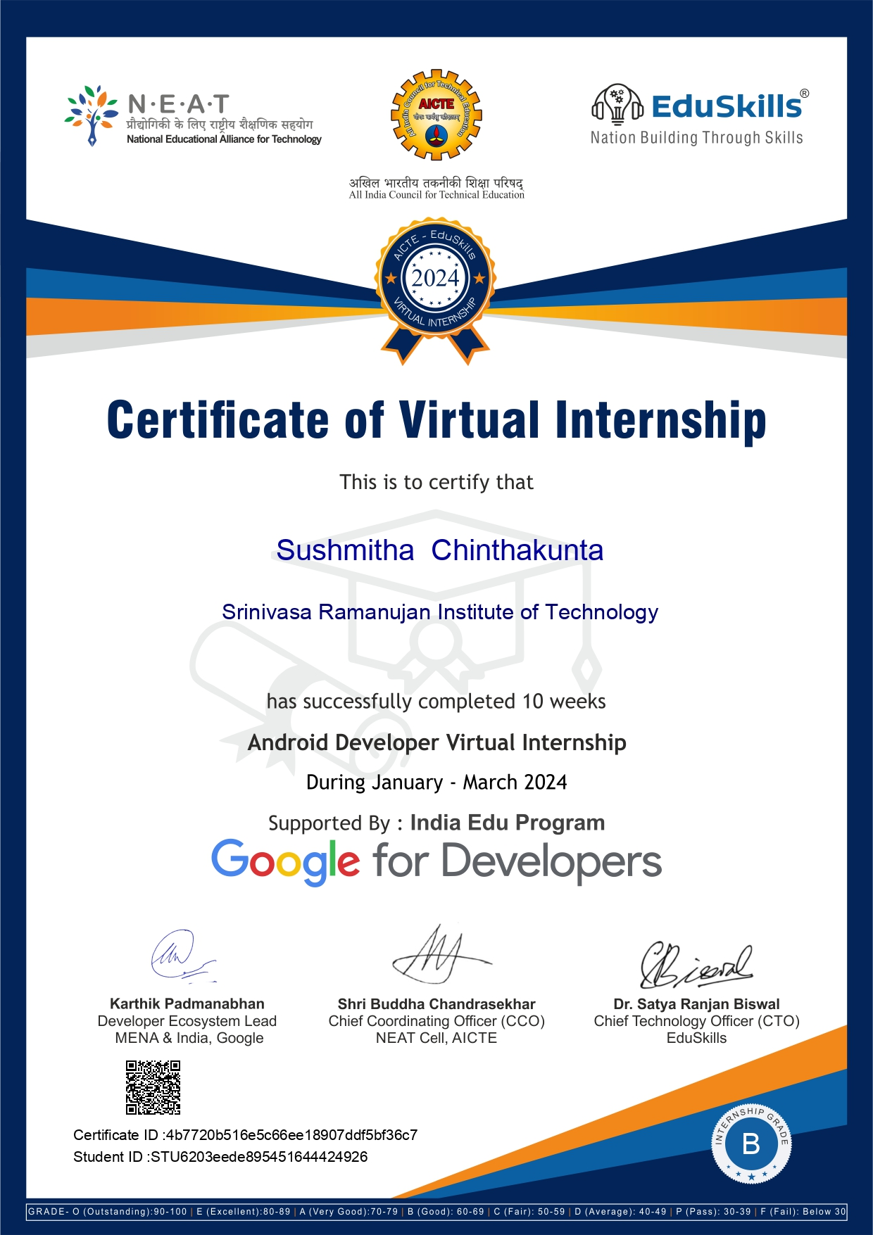
Internship Certificate

Slide 16
Thank You!!!

